Slide 1

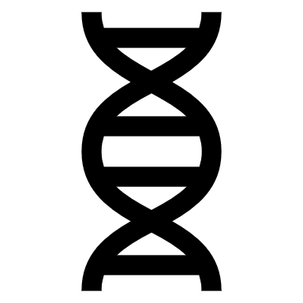
MOLECULAR GENETICS LABORATORY BT344 Experiment (3)
DNA Isolation

Slide 2

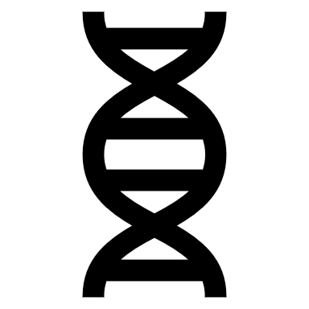
OBJECTIVE
To explain and understand the basic principle of DNA isolation from Drosophila melanogaster

Slide 3
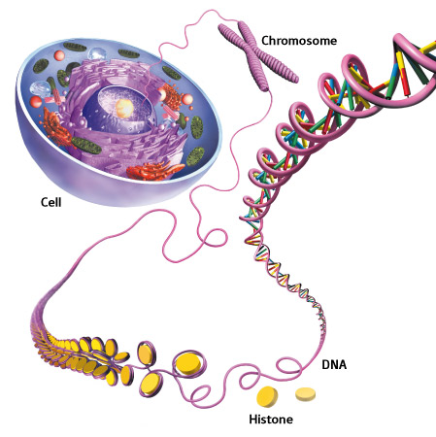
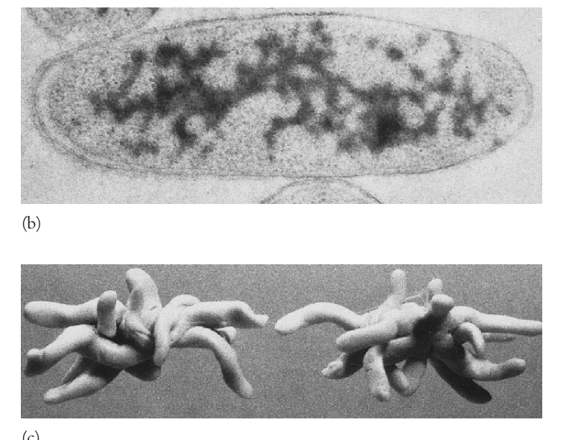
DNA inside cells
Eukaryotic cells
Prokaryotic cells
www.rikenresearch.riken.jp/eng/frontline/5514
Prescott M. (2002) Microbiology

Slide 4
DNA isolation
DNA isolation is the extraction and purification of DNA (deoxyribonucleic acid)
After DNA is extracted, it is used as a template in further molecular techniques such as…
PCR (polymerase chain reaction)
RFLP (restriction fragment length polymorphism)
Southern Blotting
Ect …….

Slide 5
Major steps in DNA isolation
Cell lysis
Remove of contaminants
DNA precipitation
DNA washing
DNA resuspension (rehydration)

Slide 6
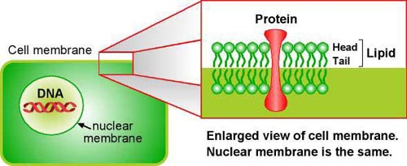
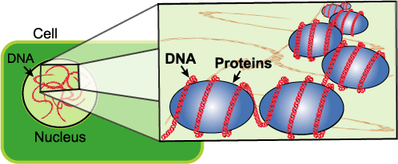
To isolate DNA, You Must Remove …
Cell membrane
Cell wall
(plant, bacteria & fungi)
Cytoplasm
Nuclear membrane (animal & plant)
Proteins, polysaccharides & lipids
http://gslc.genetics.utah.edu/units/activities/
extraction
http://gslc.genetics.utah.edu/units/activities/
extraction

Slide 7
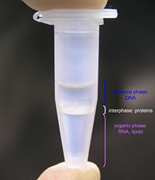
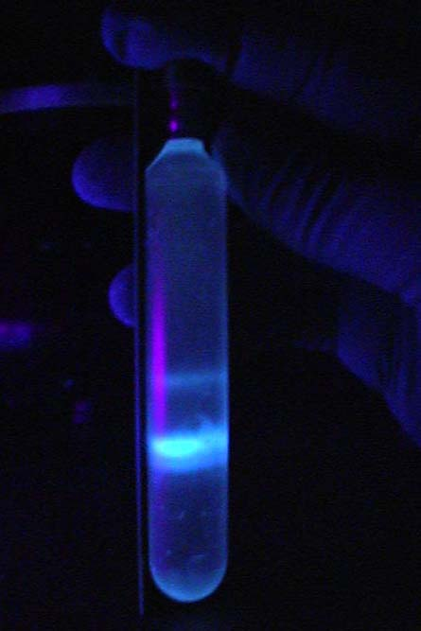
Types of Methods
Differential solubility
Organic solvents
Salting-out
Adsorption methods
Density gradient centrifugation
openwetware.org/wiki/Phenol/chloroform_extraction
https://classshares.student.usp.ac.fj

Slide 8
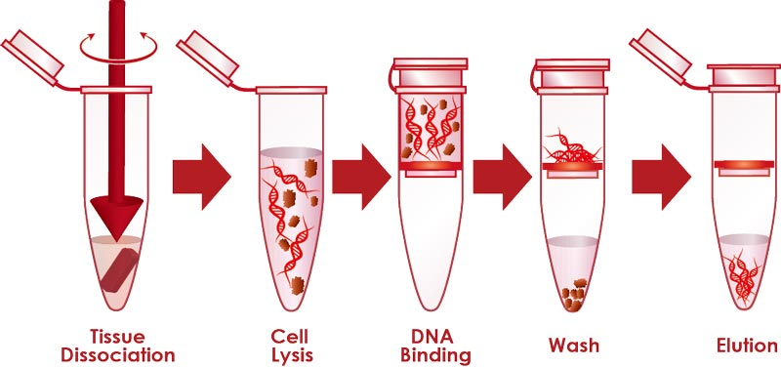
Adsorption method

Slide 9
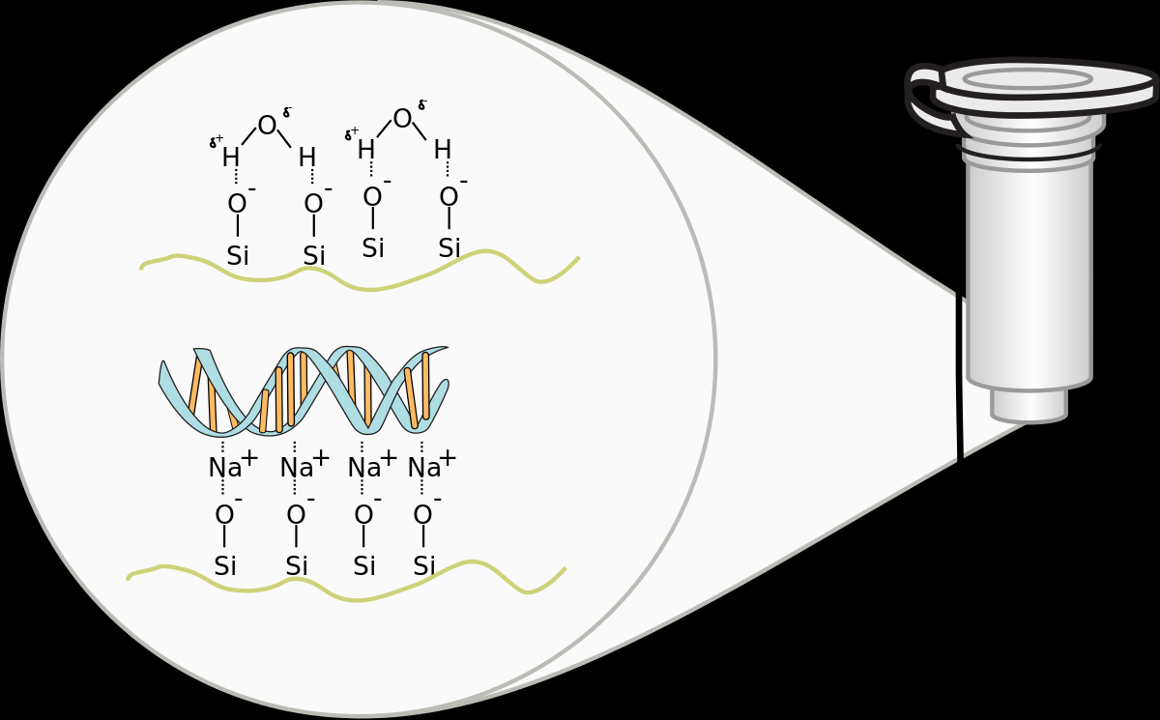

Slide 10
Differential solubility / Organic solvents
EDTA binds up Mg++ ions, which is a necessary cofactor of DNases, which degrade the DNA. These ions interfere with the action of detergents. The EDTA binds to them(ions), sequestering them and preventing their interference.
TRIS – to maintain the pH of the DNA
SDS which disrupts the lipid layers, helps to dissolve membranes & binds positive charges of chromosomal proteins (histones) to release the DNA into the solution.
Frozen fruit flies
&
squishing buffer
A
Fruit flies Lysis with
Detergent (SDS)
Proteinase k
NaCl
NaCl so that DNA is stabilised and remains as a double helix.
SDS which disrupts the lipid layers, helps to dissolve membranes & binds positive charges of chromosomal proteins (histones) to release the DNA into the solution.
Proteinase K to digest the proteins, deproteinization of DNA and inactivation of DNAse elevated temperature (Also 65ºC to inhibit degradation by DNAses).
B
Organic solvent extraction
(phenol:chloroform:isoamyl alcohol)
Phenol removes proteins
Chloroform & isoamyl alcohol remove phenol & lipids & carbohydrates
C

Slide 11
Differential solubility / Organic solvents
DNA precipitation by isopropanol/ethanol & sodium salt
Sodium Salt – Na+ ions bind to DNA, decreasing its negative charge allowing DNA molecules to come closer together and spool. NaCl is to keep the DNA in its double helix form, otherwise it would denature and become "ssDNA”.
Alcoholol – precipitate DNA which is repelled by nonpolar solutions.
D
DNA washing by 70% ethanol
70% ethanol - Wash the DNA to remove residual salts and other contaminants.
E
Air drying & resuspenstion in sterile H₂O or TE
Air drying removes ethanol
H₂O or TE dissolve DNA pellet
F

Slide 12
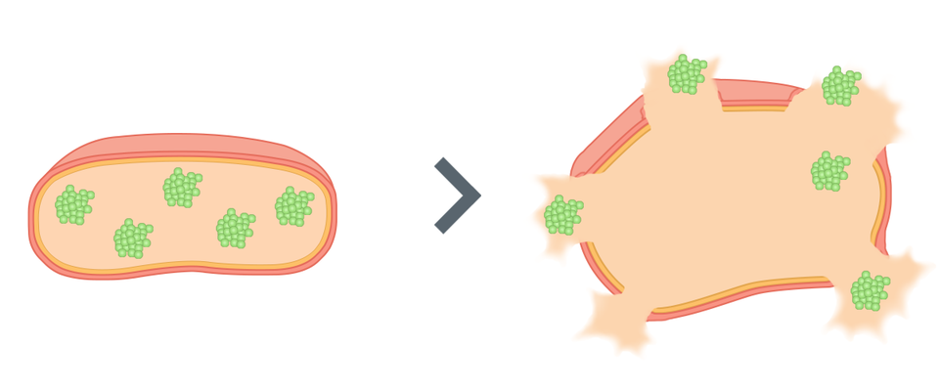

Differential solubility / Organic solvents
A
B
Add squishing buffer &
Grinding
Add lysis buffer & proteinase K
Frozen fruit flies
Cells are lysed, DNA in solution

Slide 13
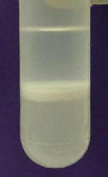
Differential solubility / Organic solvents
C
Mix thoroughly with an equal volume of organic solvent
Aqueous
Centrifuge
Collect aqueous phase
e.g. phenol, chloroform, or phenol:chloroform
Interphase
Organic
Perform additional extractions for increased purity
Crude lysate containing nucleic acids and other cell constituents
The aqueous phase contains water-soluble molecules, including nucleic acids. Proteins and lipids become trapped in the organic phase, and are thus separated away. Insoluble debris become trapped in the interphase between the two layers

Slide 14
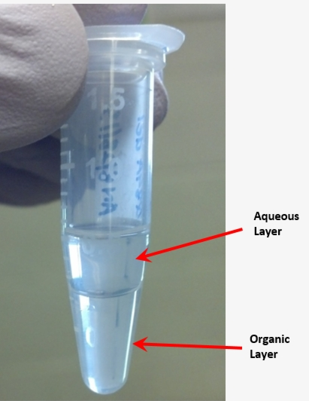
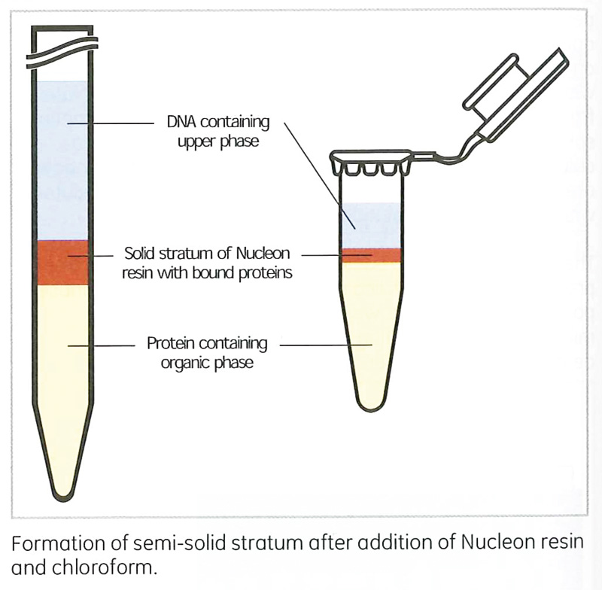
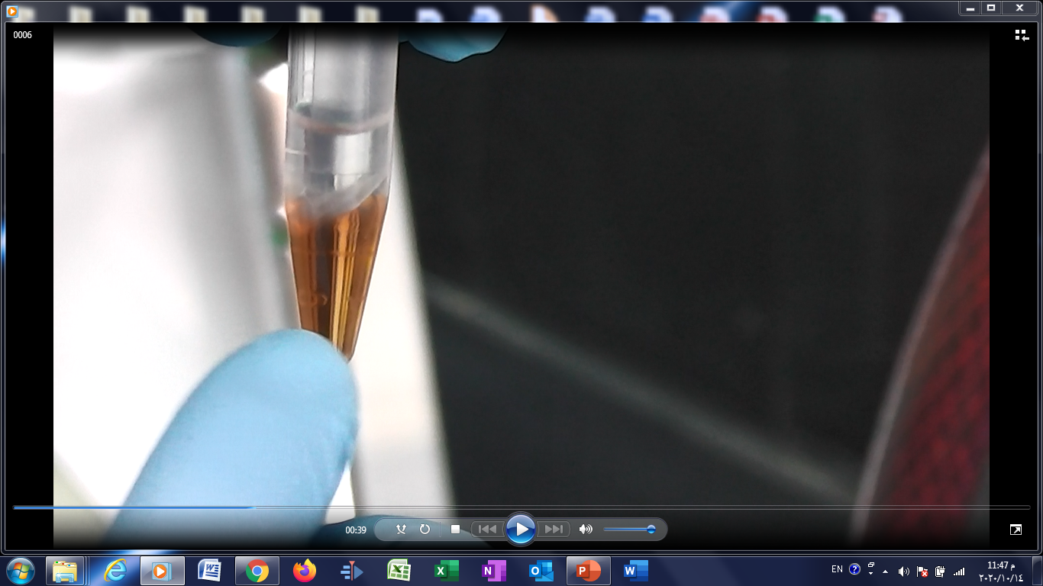

Slide 15
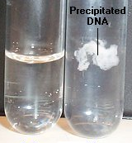
Differential solubility / Organic solvents
D
E
F
Supernatant
70% EtOH
Add alcohol & salt
Centrifuge
Wash
Centrifuge
Pellet
Dissolve pellet (H₂O, TE, etc.)
Before
After
Aqueous phase containing DNA

